Slide 1
Data Science and Artificial Intelligence: Project

Slide 2

Final Project: By Vivek Kulthe
Why Do Employees Quit?
Employee Attrition Analysis & Prediction
Notes:
Final Project, Part 1: Outline Your Project

Slide 3


Background
Organization Background: ABC Technologies, is facing a concerning trend of high employee attrition even though they offer a competitive salary and benefits package.
Problem Statement: This suggests the root cause of attrition lies beyond financial compensation. Company wants to identify the underlying factors driving employee departures to improve retention and maintain a strong talent pool.
Challenges Faced:
Reputational
Damage
Project Delays
Low Morale
Recruitment
Cost Increase
Training
Cost Increase

Slide 4



Background (Team Background)
ABC Technologies has formed its HR Analytics Team with a combined skillset of HR expertise and data analytics
This team is expected to work with other teams such as Survey team, Communications team, HR Apps team and Data Engineering team to leverage existing employee data from HR applications and conduct targeted surveys to gather additional insights
This data-driven approach will allow for a deeper understanding of why employees leave, ultimately leading to a stronger talent pool for the company

Slide 5









Background (Skills & Resources Requirement)
Other Teams / Resources Needed:
Required Skills / Tools / Libraries:
Survey team to create targeted surveys in collaboration with HR experts
Internal Comms team to circulate and get survey responses from employees
HR Apps team to provide employee data that is already available through HR Applications
Data Engineering team to source & process raw data for further analytics and ML model building
Data Scientist to do Analytics and ML Model building

Slide 6


Objective
Identify factors influencing employee departures from ABC Technologies
Develop a model to predict the likelihood of employee attrition
GOAL
Analyze employee data to uncover trends and patterns related to employee attrition.
Build a logistic regression model to predict employee departure probability
Identify key attributes associated with departing employees
Use employee data as input features to train the model
Visualize data to present findings clearly and concisely
Analyze model performance to identify the most significant predictors of attrition
EXPECTATIONS

Slide 7
Objective (Expectations)
Analyze & Visualize the employee data to uncover trends and patterns related to employee attrition
Identify key attributes associated with departing employees, viz;
Demographic Factors
Compensation and Benefits
Work Environment
Job Satisfaction
Managerial Influence
Career Progression
Build a Classification Model to predict if an employee is at a risk of attrition
Analyze model performance to identify the most significant factors of attrition
Provide recommendation to reduce the attrition

Slide 8
Objective (Benefits)
Improved
Employer
Reputation
Improved
Training
ROI
Lower Recruitment
Efforts
Proactive
Talent
Management
On-Time
Project
Deliveries
Increased
Employee
Satisfaction
Boosted
Team
Morale

Slide 9





Approach / Methodology (EDA Framework)
CRISP-DM
OSEMN
Obtaining
Data
Scrubbing
Data
Exploring
Data
Modeling
Data
iNterpreting
Data
CRISP-DM is a traditional, iterative framework
Better for traditional sectors and stakeholders
CRISP-DM include business-focused phases like deployment, operations, and optimization
Does not appeal where the data is not going to be iterative that required continuous learning and enhancement of the model
A popular, non-iterative model
Better for smaller and more focused projects, such as exploratory research
It's a higher-level approach that doesn't include business-focused phases like deployment, operations, and optimization.
OSEMN is appealing for startups or educational projects that want to iterate quickly

Slide 10






Analytical Technique (EDA Framework)
OSEMN
Obtaining
Data
Scrubbing
Data
Exploring
Data
Modeling
Data
iNterpreting
Data
Gather data from relevant sources
Clean data to formats that machine understands
Find patterns and trends using statistical methods
Construct models predict and forecast
Put the results into good use
Data Mining
Data
Cleansing
Descriptive
Analytics
Diagnostic
Analytics
Predictive
Analytics
Prescriptive
Analytics

Slide 11
Analytical Technique (ML Model)
Key Factor To Decide Between Supervised and Unsupervised Learning:
We have chosen Supervised Learning in this scenario as we have a labeled dataset and aim to make predictions.
Supervised Learning is ideal for tasks like employee churn prediction, where our goal is to classify categories or predict continuous values based on past data.
Key factor to deciding between Classification and Regression lies in target variable:
Classification: Classification model is used when target variable is discrete and falls into distinct categories. These categories can be binary (like Attrition Yes/No) or have multiple classes (e.g., classifying handwritten digits into 0-9).
Regression: Regression model is used when target variable is continuous. This means it can take on any numerical value within a range. Common examples include predicting house prices, weather forecasts (temperature), or customer lifetime value.
Machine Learning
Supervised Learning
Unsupervised Learning
Reinforcement Learning
Classification
Regression
Clustering
Decision Making
Logistic Regression
K-Nearest Neighbor
Support Vector Machine
Decision Tree
Random Forest
XGBoost
Linear Regression
Neural Network Regression
Support Vector Regression
Decision Tree Regression
Lasso Regression
Ridge Regression
K-Means Clustering
Mean-shift Clustering
DBSCAN Clustering
Agglomerative Hierarchical Clustering
Gaussian Mixture
Q-Learning
R Learning
TD Learning

Slide 12
Obtaining Data
OSEMN
Obtaining
Data
Scrubbing
Data
Exploring
Data
Modeling
Data
iNterpreting
Data
Gather data from relevant sources
Clean data to formats that machine understands
Find patterns and trends using statistical methods
Construct models predict and forecast
Put the results into good use
Data Mining
Data
Cleansing
Descriptive
Analytics
Diagnostic
Analytics
Predictive
Analytics
Prescriptive
Analytics

Slide 13
Obtaining Data
The dataset used is taken from kaggle and contains HR analytics data of employees that stay and leave
Factors & Attributes in the Dataset:
Total Number of Records: 1470
Classification Target: Attrition (Yes or No)
Asset | License | Source Link
Employee Attrition Data | Open Database License (ODbL) | Kaggle
 | Database Content license (DbCL)
Career Progression | Compensation & Benefits | Demographic Factors | Job Satisfaction | Work Environment
JobLevel | DailyRate | Age | JobInvolvement | BusinessTravel
PerformanceRating | HourlyRate | Education | JobRole | Department
TotalWorkingYears | MonthlyIncome | EducationField | JobSatisfaction | DistanceFromHome
TrainingTimesLastYear | PercentSalaryHike | Gender | RelationshipSatisfaction | EmployeeCount
YearsAtCompany | StockOptionLevel | MaritalStatus |  | EnvironmentSatisfaction
YearsInCurrentRole |  | NumCompaniesWorked |  | OverTime

Slide 14
Scrubbing Data
OSEMN
Obtaining
Data
Scrubbing
Data
Exploring
Data
Modeling
Data
iNterpreting
Data
Gather data from relevant sources
Clean data to formats that machine understands
Find patterns and trends using statistical methods
Construct models predict and forecast
Put the results into good use
Data Mining
Data
Cleansing
Descriptive
Analytics
Diagnostic
Analytics
Predictive
Analytics
Prescriptive
Analytics

Slide 15
Scrubbing Data
Handling Single & Unique Data:
</> : df_clean.nunique()
Single data: EmployeeCount, Over18, StandardHours are columns that single/same value across all records.
Unique data: EmployeeNumber is a column whose entire row contains a unique value
And hence these columns will not add any value to our analysis and “can be dropped”
Handling Missing Data:
</> : df_clean.isnull().sum()
There is “no empty (NULL) data” in any column in the data frame
Handling Duplicated Data:
</> : df_clean.duplicated().sum()
There are “no duplicates” in any of the column

Slide 16
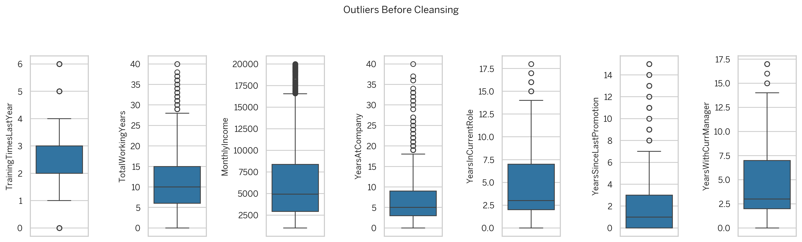
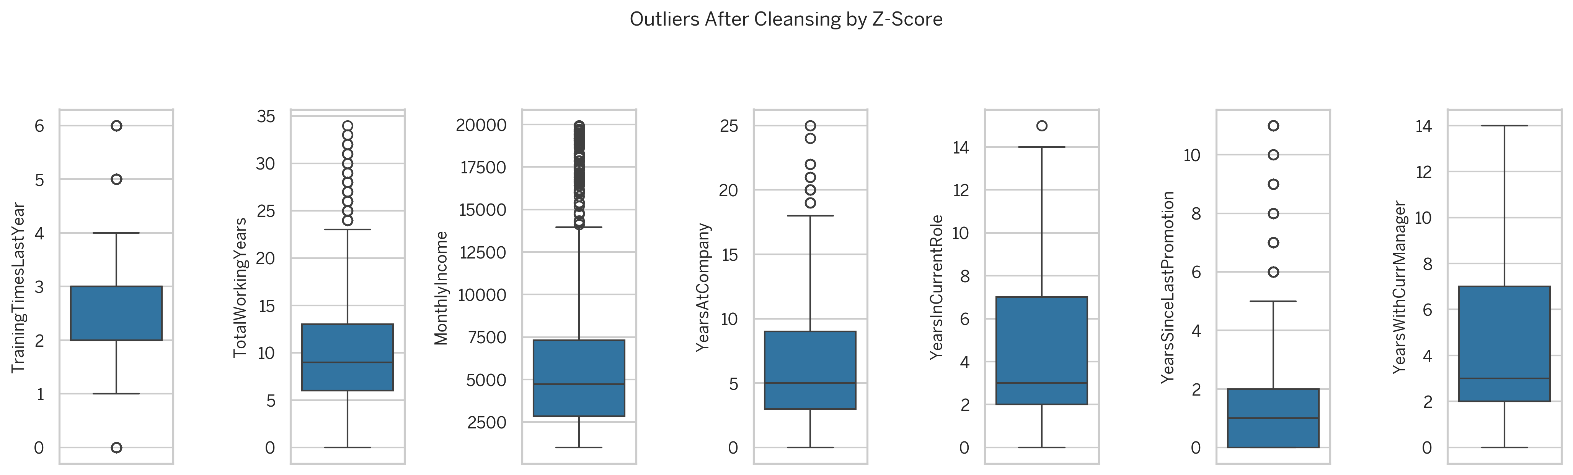
Scrubbing Data (continued)
Handling Outliers:
To identify the outliers in the data, the box plots are used.
Based on the boxplots, we can see that there are outliers in the following columns:
TotalWorkingYears
TrainingTimesLastYear
YearsAtCompany
YearsInCurrentRole
YearsSinceLastPromotion
YearsWithCurrManager
MonthlyIncome
The outliers in the data are removed using Z-Score method:
Calculated the absolute z-score
Kept <3 absolute z-scores
Filtered out records whose Z-Scores are below 3
Number of rows after removing outliers: 1387
Before Removing Outliers ↓
After Removing Outliers ↑

Slide 17
Exploring Data (Descriptive Analytics)
OSEMN
Obtaining
Data
Scrubbing
Data
Exploring
Data
Modeling
Data
iNterpreting
Data
Gather data from relevant sources
Clean data to formats that machine understands
Find patterns and trends using statistical methods
Construct models predict and forecast
Put the results into good use
Data Mining
Data
Cleansing
Descriptive
Analytics
Diagnostic
Analytics
Predictive
Analytics
Prescriptive
Analytics

Slide 18
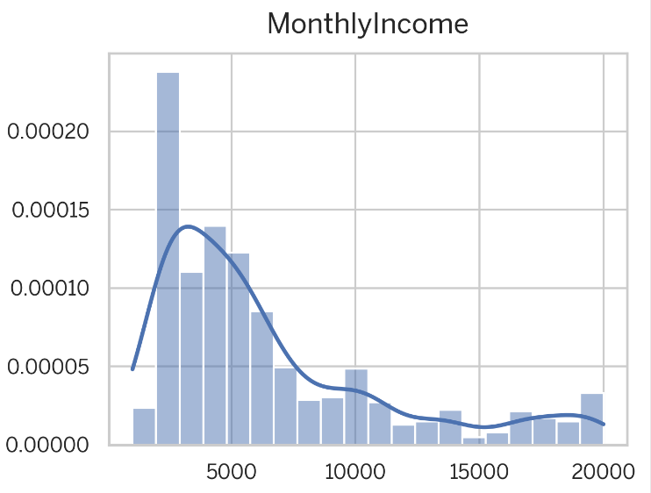
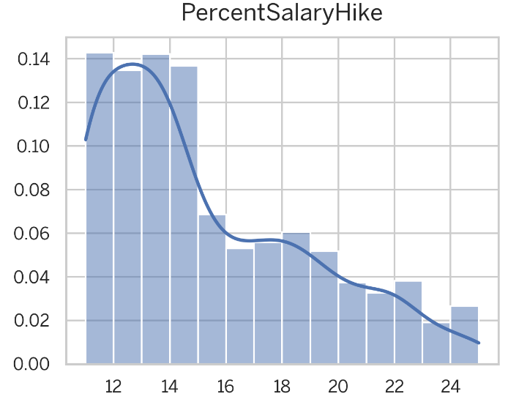
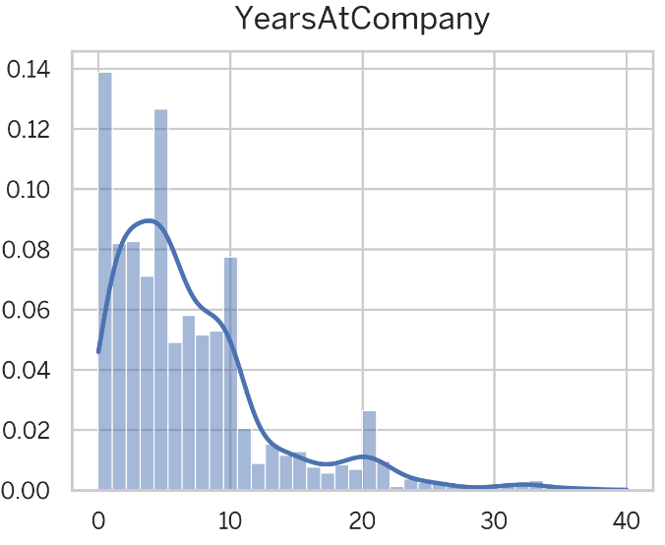
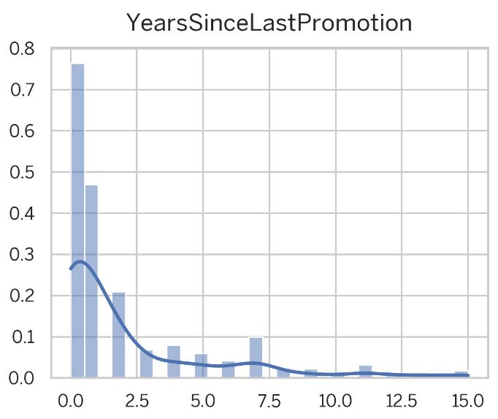
Exploring Data (Descriptive Analytics)
Using Quantitative Feature Distribution (Histogram)
The histograms shows large number of employees are having low monthly income (in the range of 2000-2500)
The histograms reveals most of the employees have received hike less than 15%
The histogram shows that a large number of employees are new hires, signifying the company has seen a recent increase in employee turnover
A large number of employees are recently promoted
Apart from those columns, the distribution looks normal
</> Link to the code and charts generated for quantitative other attributes.

Slide 19
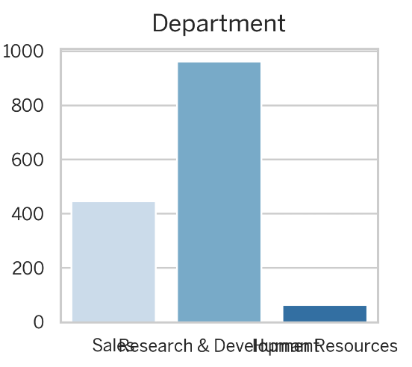
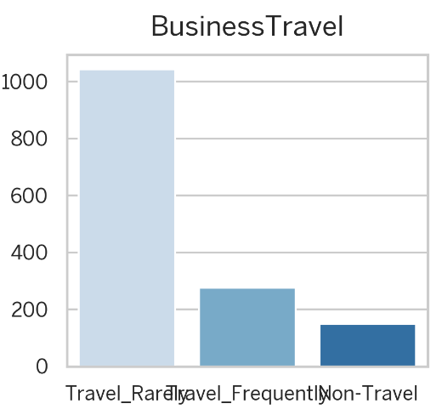
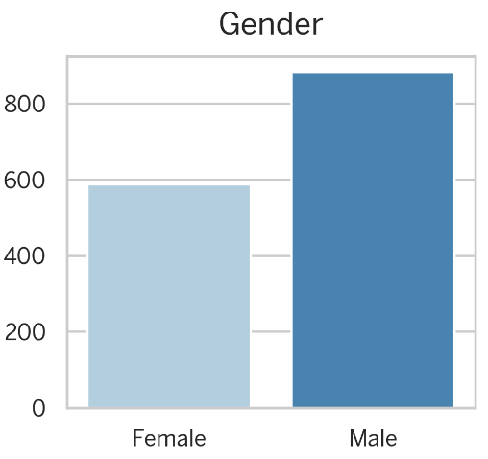
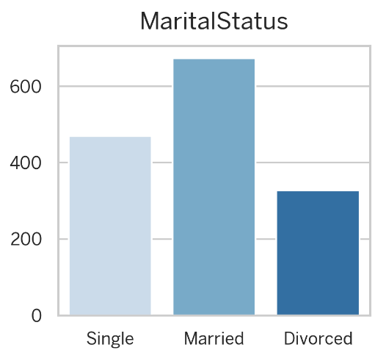
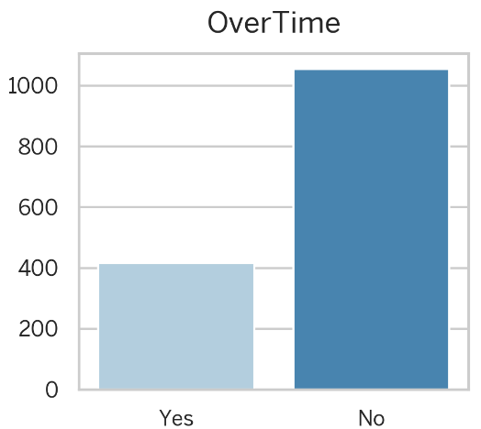
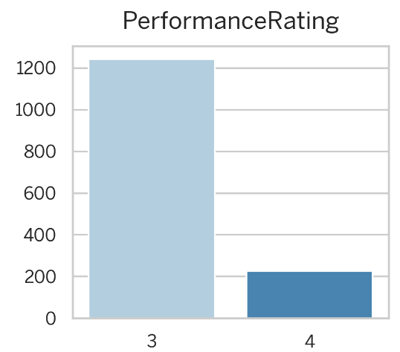
Exploring Data (Descriptive Analytics)
Using Qualitative Feature Distribution (Bar Chart)
Research & Development is the department with the largest number of employees, around 900 employees
Many employees have a high frequency of business travel, around 1000+ employees
The company is dominated by 800 male employees.
The company is dominated by married employees
Relatively small number of employees work overtime
Only a small number of employees show extraordinary performance (4: outstanding)
And there are no employees who have low performance (1: low)
</> Link to the code and charts generated for qualitative other attributes.

Slide 20
Exploring Data (Diagnostic Analytics)
OSEMN
Obtaining
Data
Scrubbing
Data
Exploring
Data
Modeling
Data
iNterpreting
Data
Gather data from relevant sources
Clean data to formats that machine understands
Find patterns and trends using statistical methods
Construct models predict and forecast
Put the results into good use
Data Mining
Data
Cleansing
Descriptive
Analytics
Diagnostic
Analytics
Predictive
Analytics
Prescriptive
Analytics

Slide 21
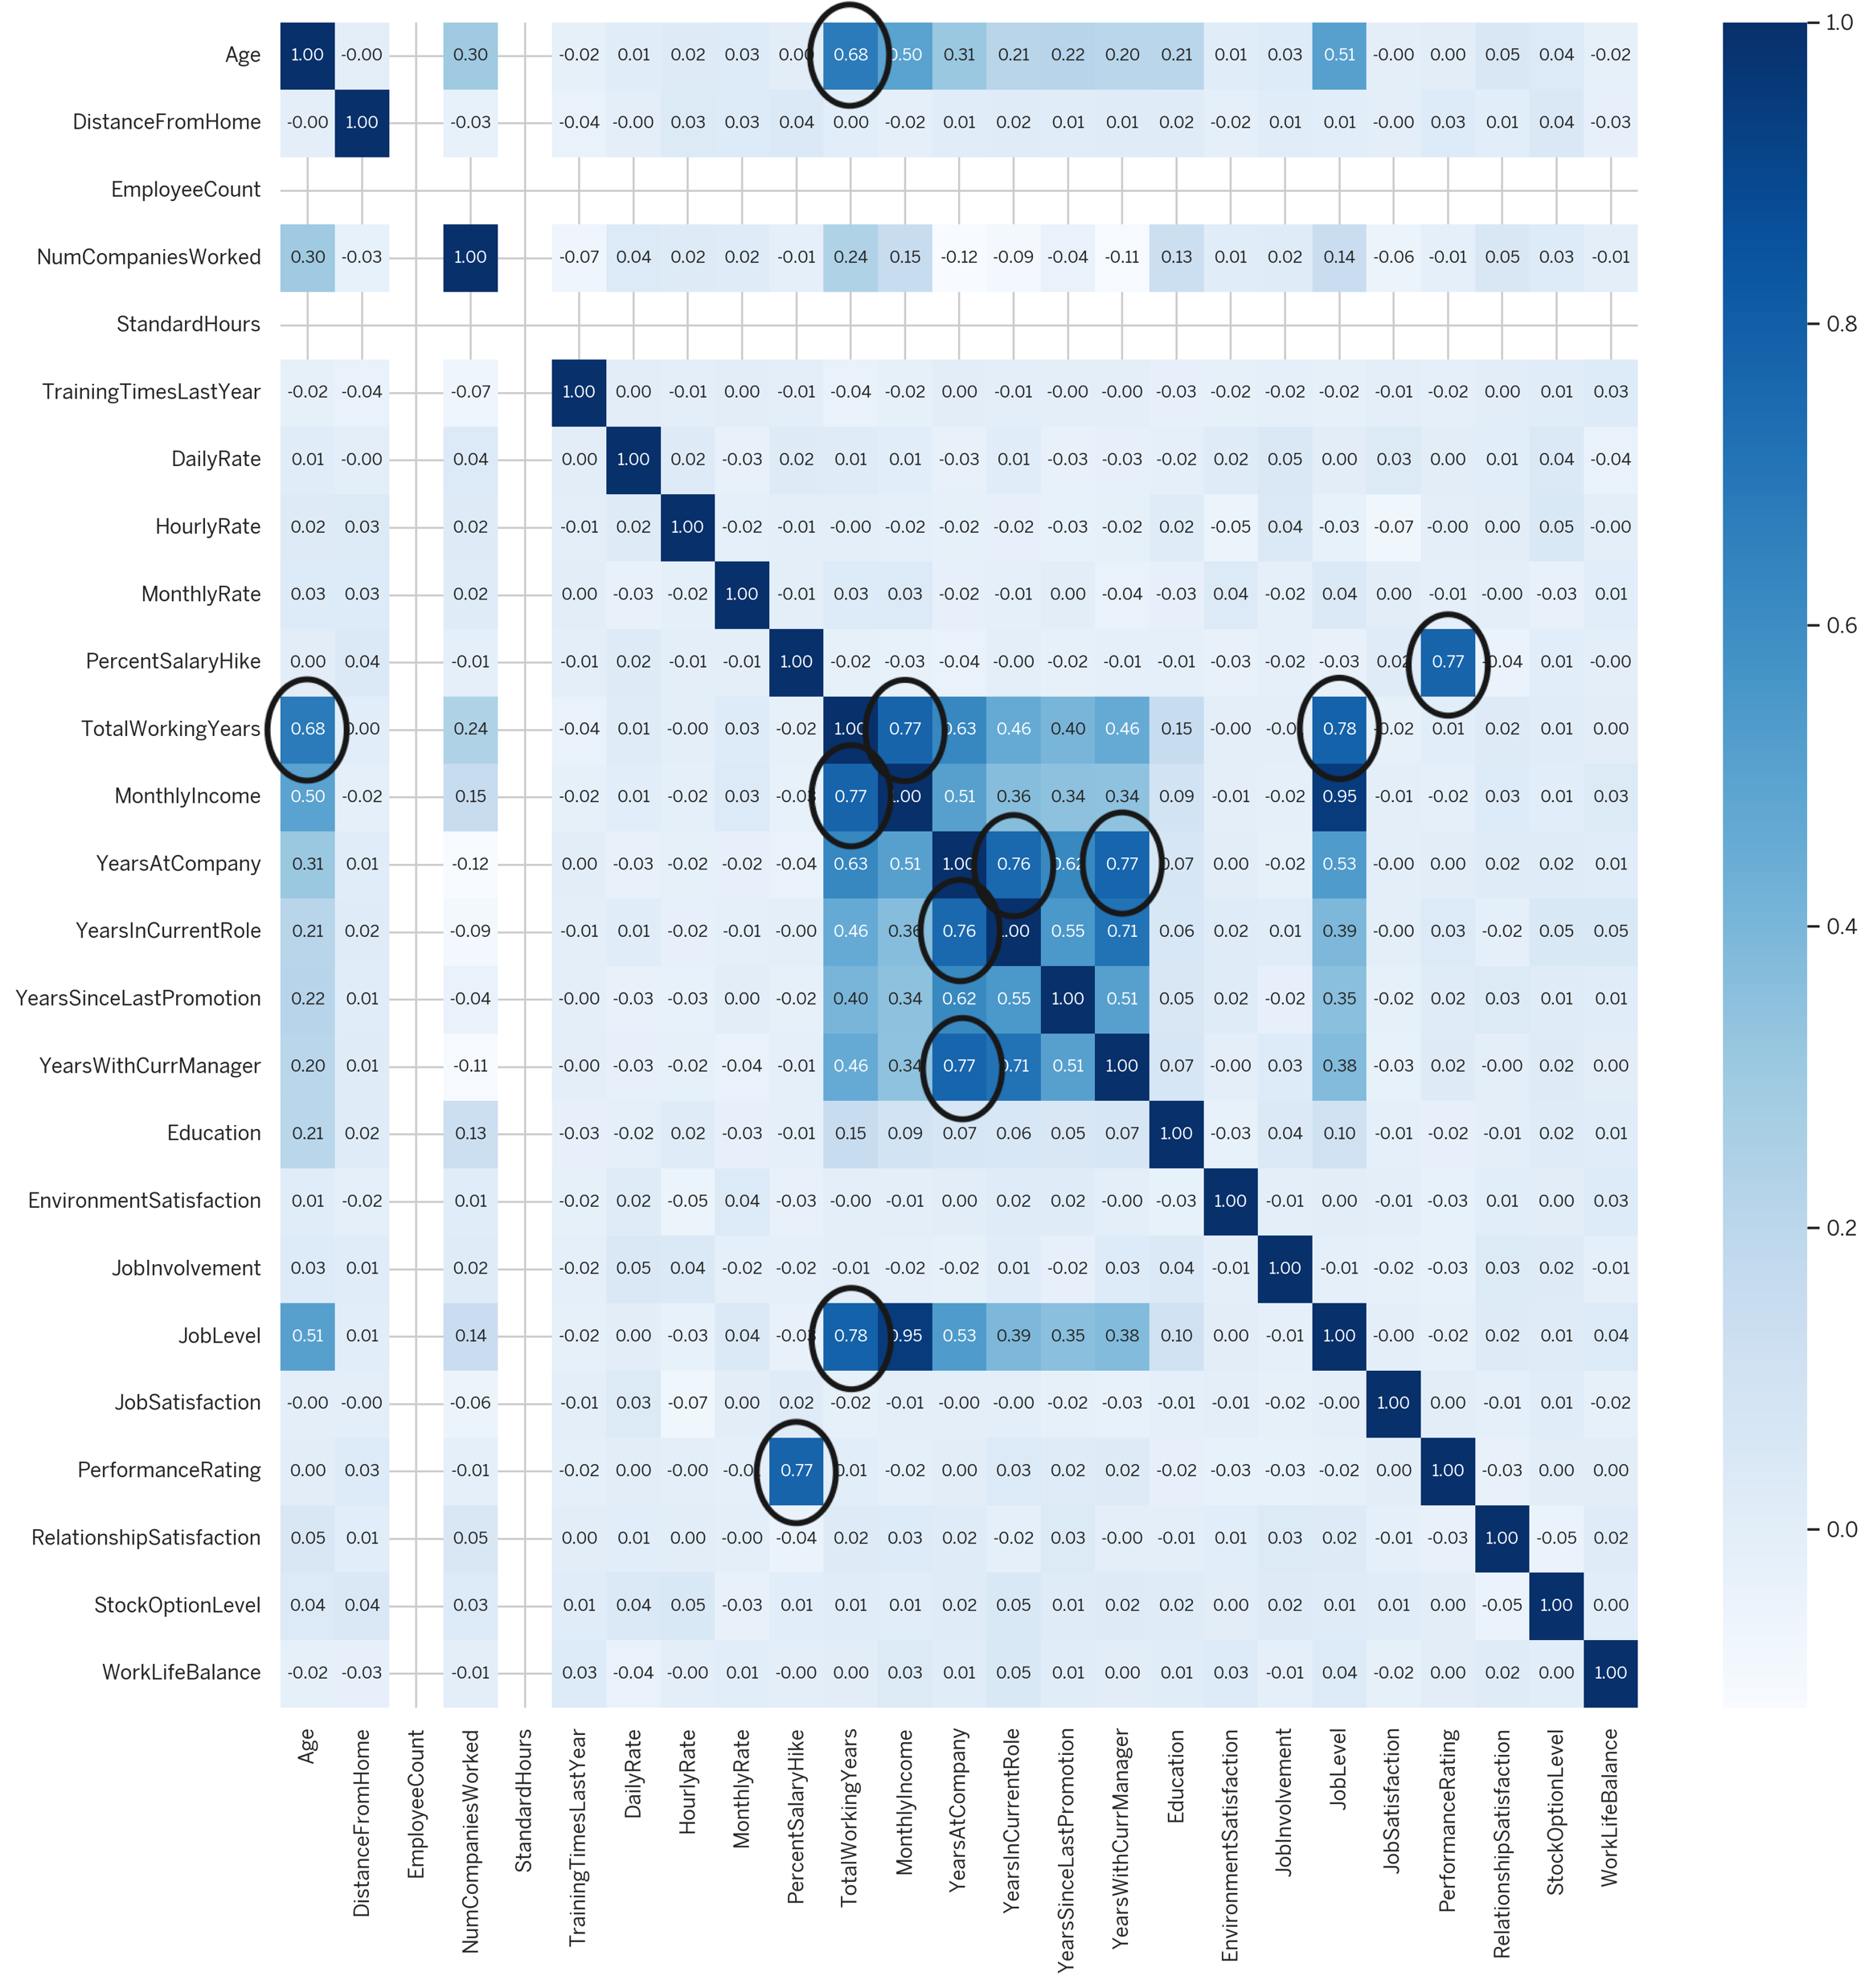
Exploring Data (Diagnostic Analytics)
Numerical & Categorical Ordinal Correlation (Heatmap)
PercentSalaryHike and PerformanceRating have a strong positive relationship
TotalWorkingYears has a strong positive relationship with Age, MonthlyIncome, and JobLevel
YearsAtCompany has a strong positive relationship with YearsInCurrentRole and YearsWithCurrManager

Slide 22
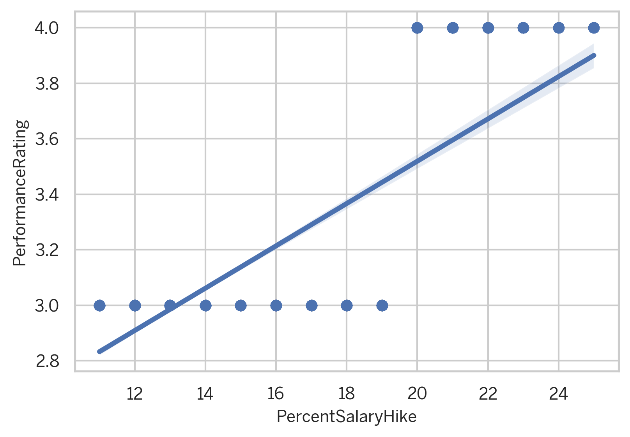
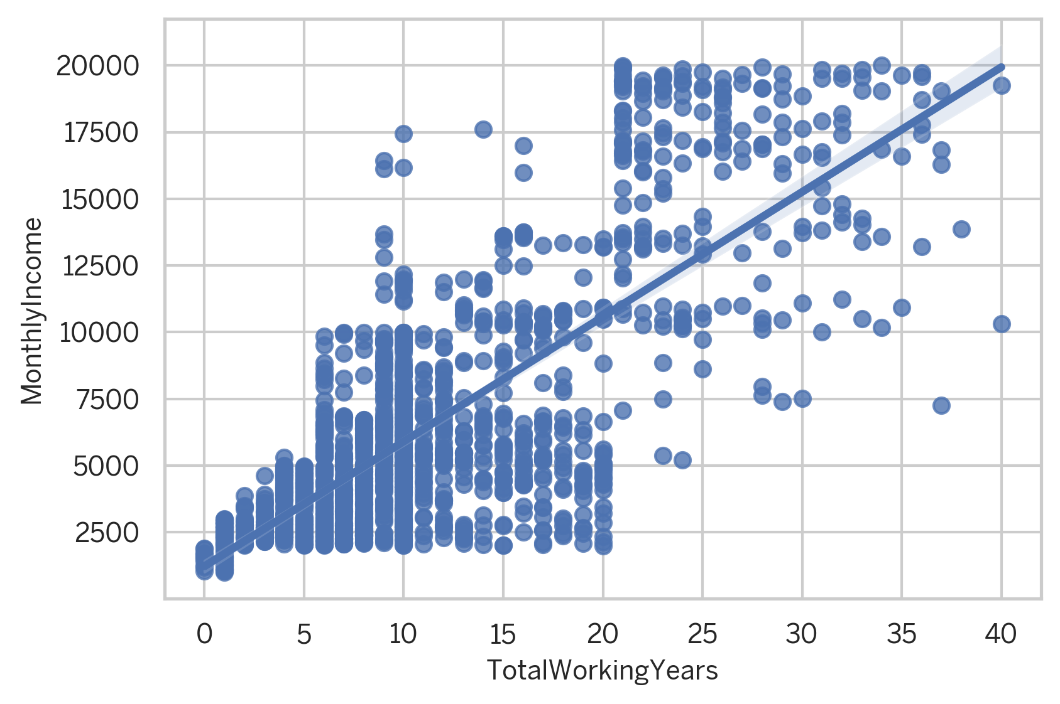
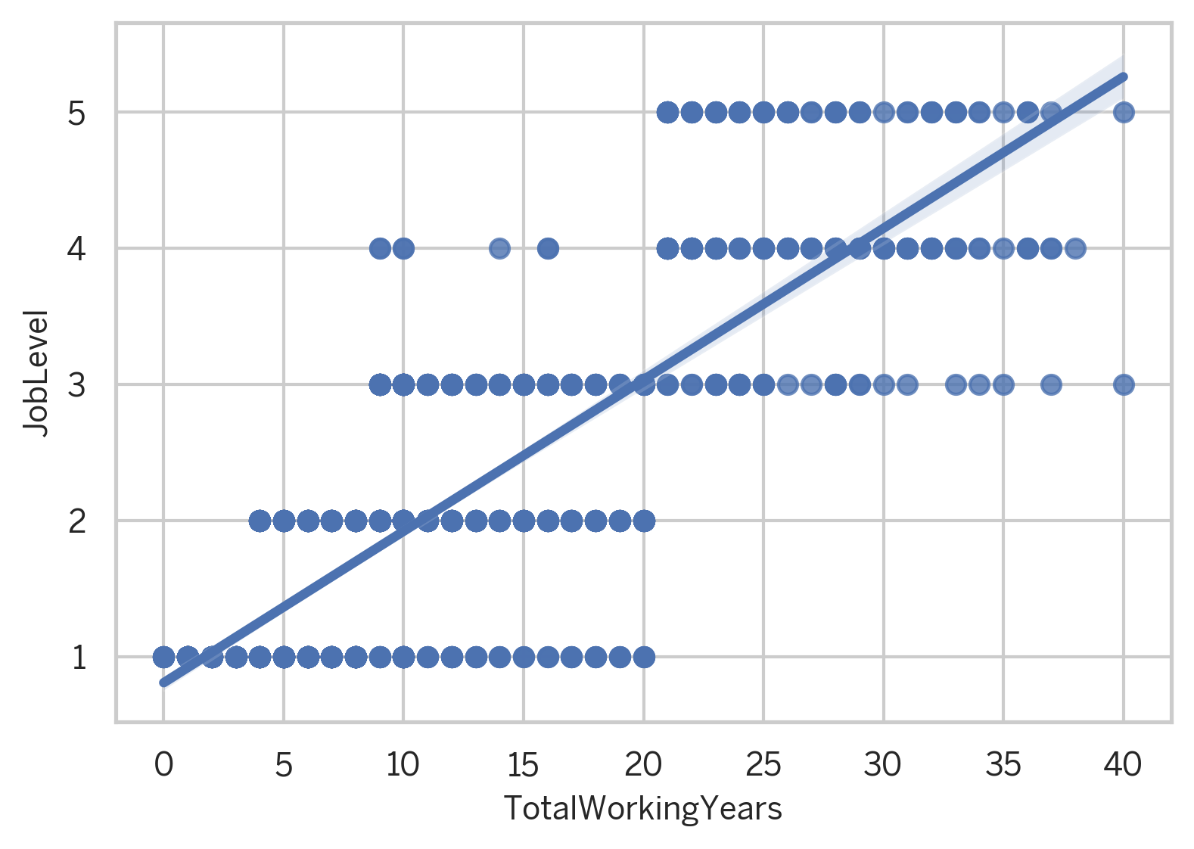
Multivariate Analysis (Correlation)
Salary has a great influence on the employee's performance
The longer employees work in the company, the more pay they will get
Most employees who are in the higher position have worked for the company for a long time

Slide 23
Exploring Data (Diagnostic Analytics)
Distribution of attributes as Qualitative and Quantitative is done so that;
Graphical analysis for Qualitative data can be done using KDE Plots
And graphical analysis for Quantitative data can be done using Bar Chart
 | Career Progression | Compensation & Benefits | Demographic Factors | Job Satisfaction | Work Environment
Analysis of Qualitative (Categorical) Data is done using KDE Plot | JobLevel | StockOptionLevel | Education | JobInvolvement | BusinessTravel
 | PerformanceRating |  | EducationField | JobRole | Department
 |  |  | Gender | JobSatisfaction | EnvironmentSatisfaction
 |  |  | MaritalStatus | RelationshipSatisfaction | OverTime
Analysis of Quantitative (Numerical) Data is done using Bar Chart | TotalWorkingYears | DailyRate | Age |  | DistanceFromHome
 | TrainingTimesLastYear | HourlyRate | NumCompaniesWorked |  | EmployeeCount
 | YearsAtCompany | MonthlyIncome
 | YearsInCurrentRole | PercentSalaryHike

Slide 24
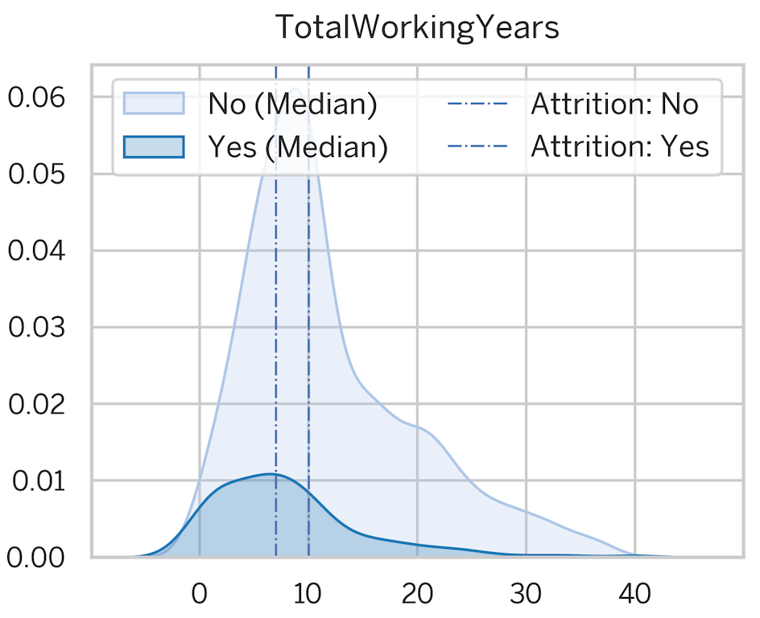
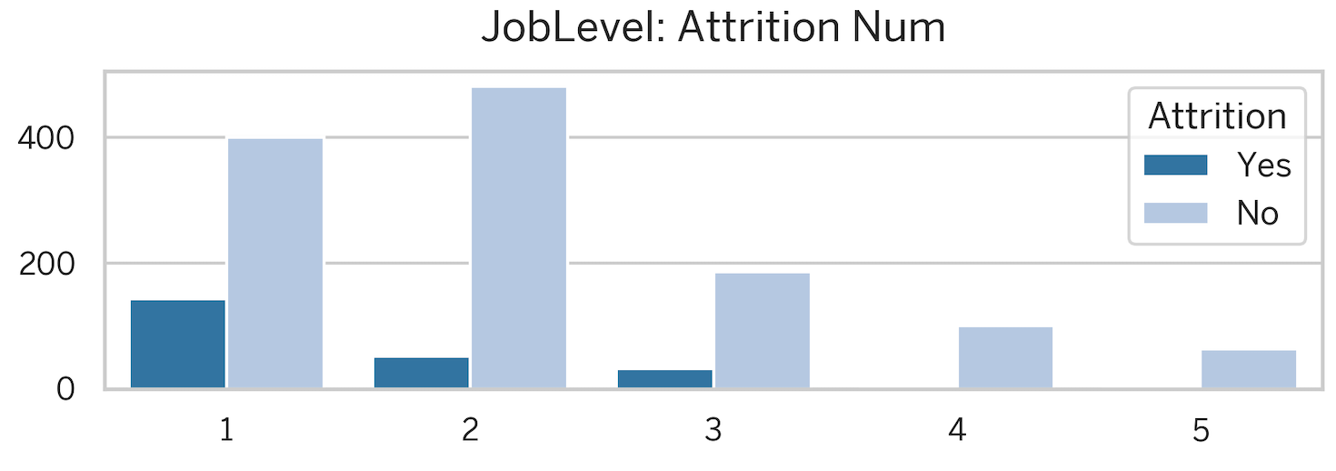
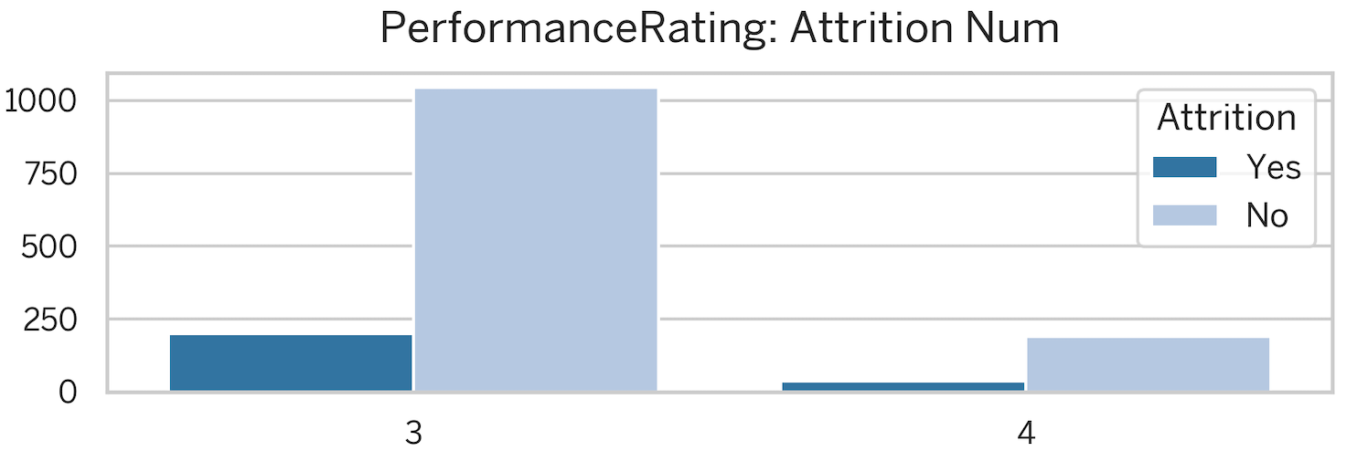
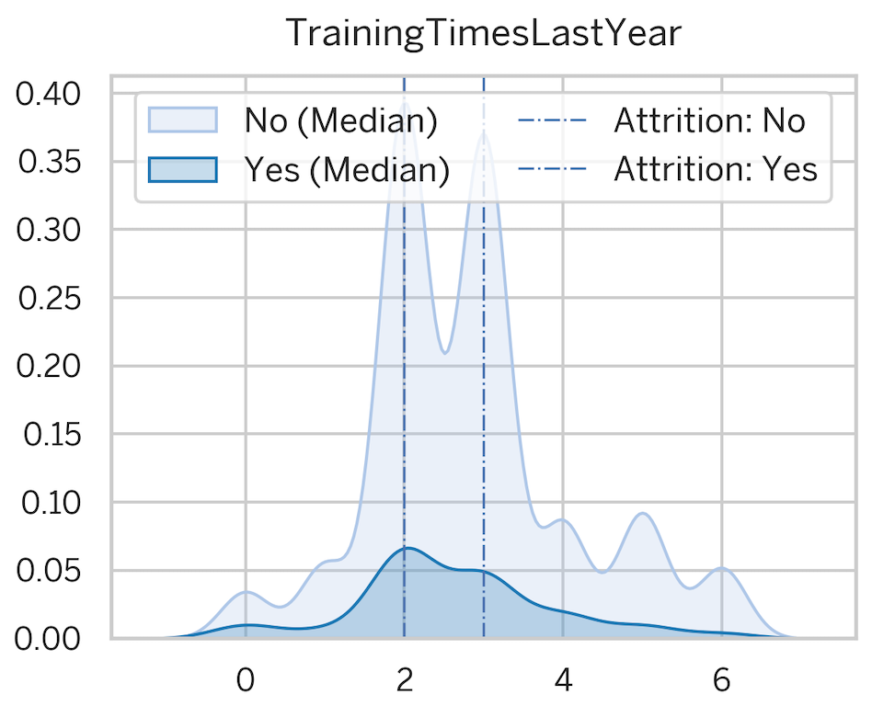
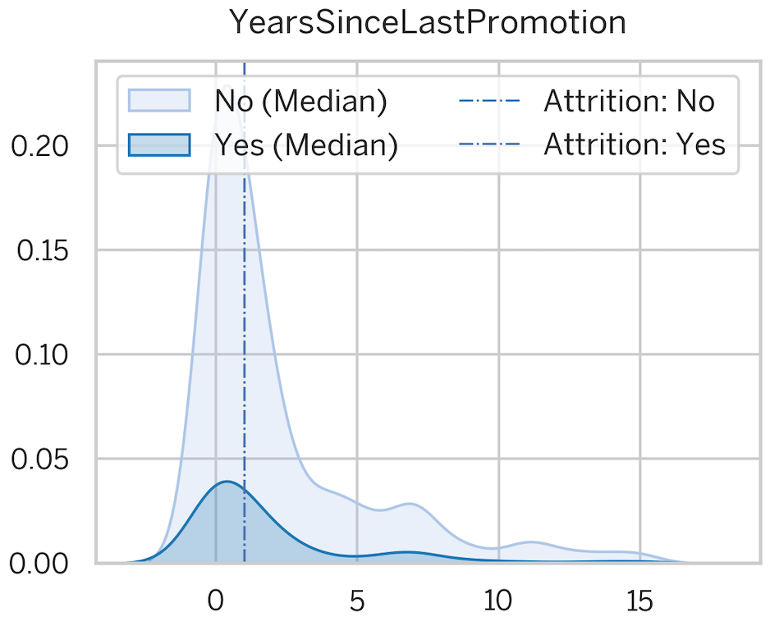
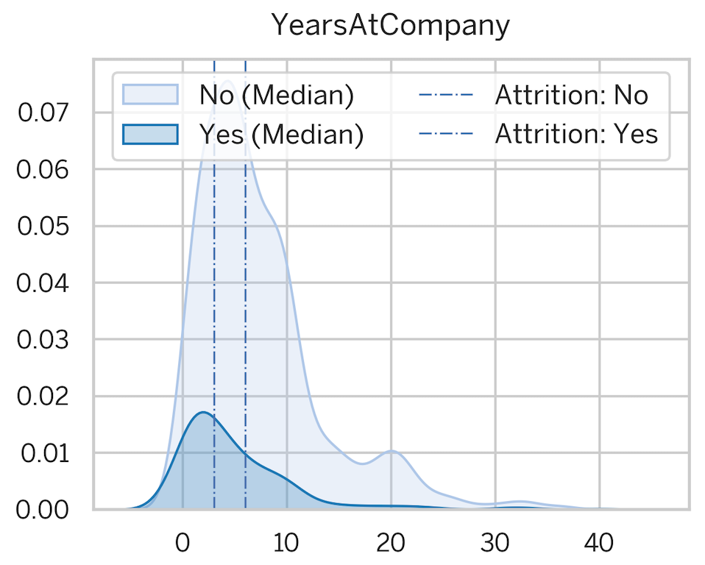
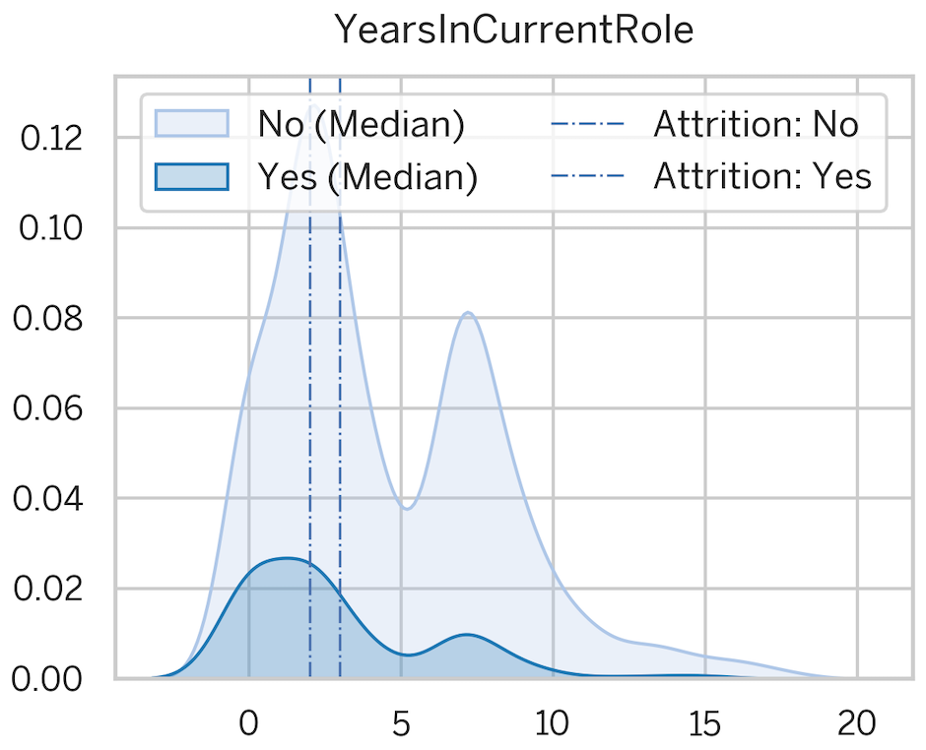
Exploring Data (Diagnostic Analytics)
How Career Progression attributes impact the attrition?
Attributes:
JobLevel, PerformanceRating, TotalWorkingYears, TrainingTimesLastYear, YearsAtCompany, YearsInCurrentRole, YearsSinceLastPromotion
Observations:
We see higher turnover among employees with fewer years of experience (0-5 years) compared to those who have been with the company for over a decade.

Slide 25
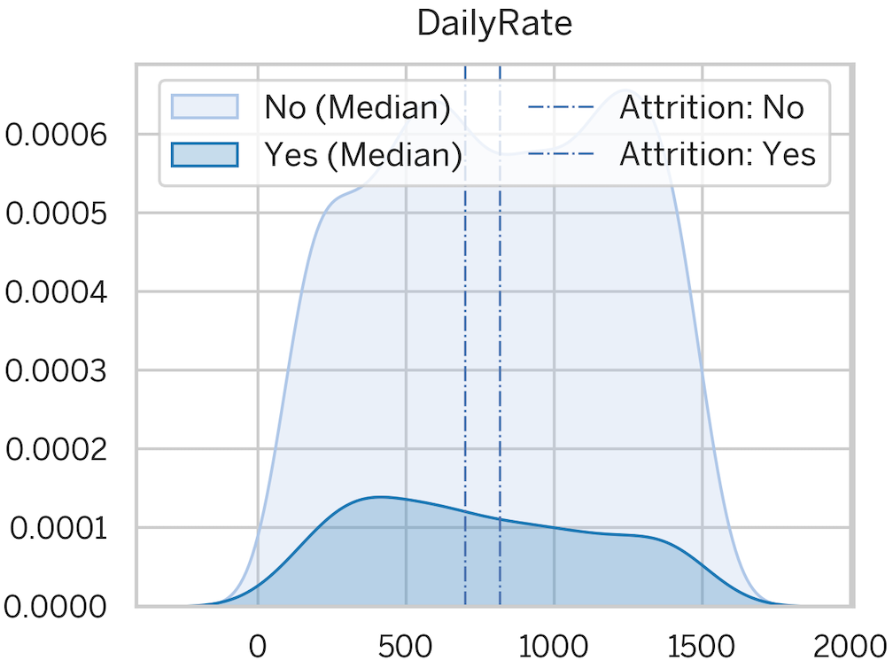
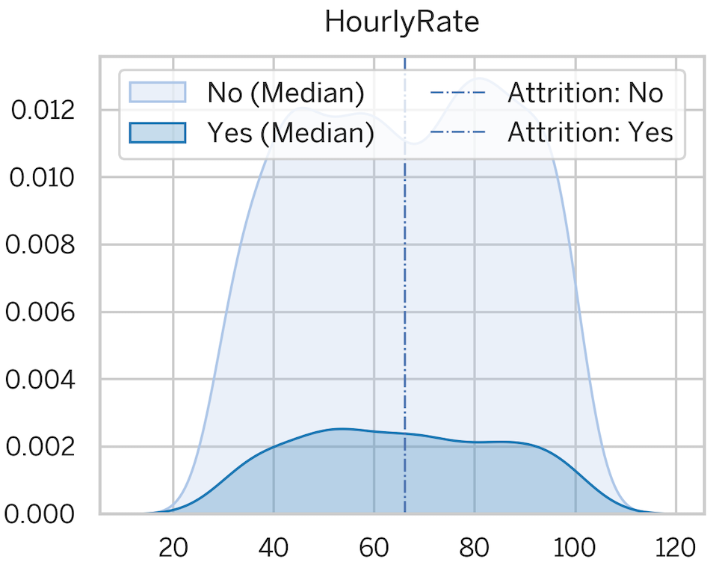
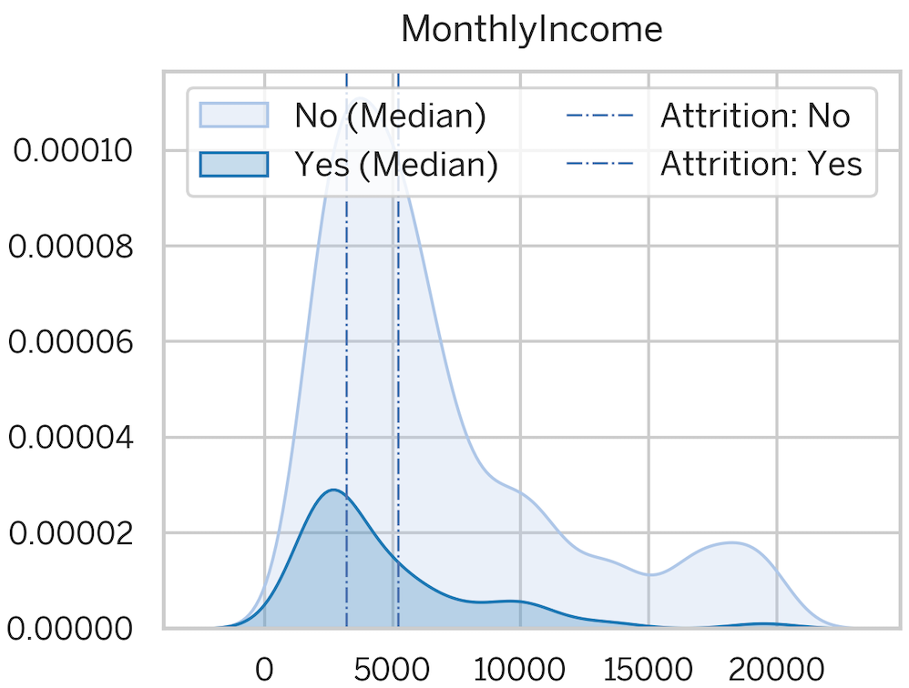
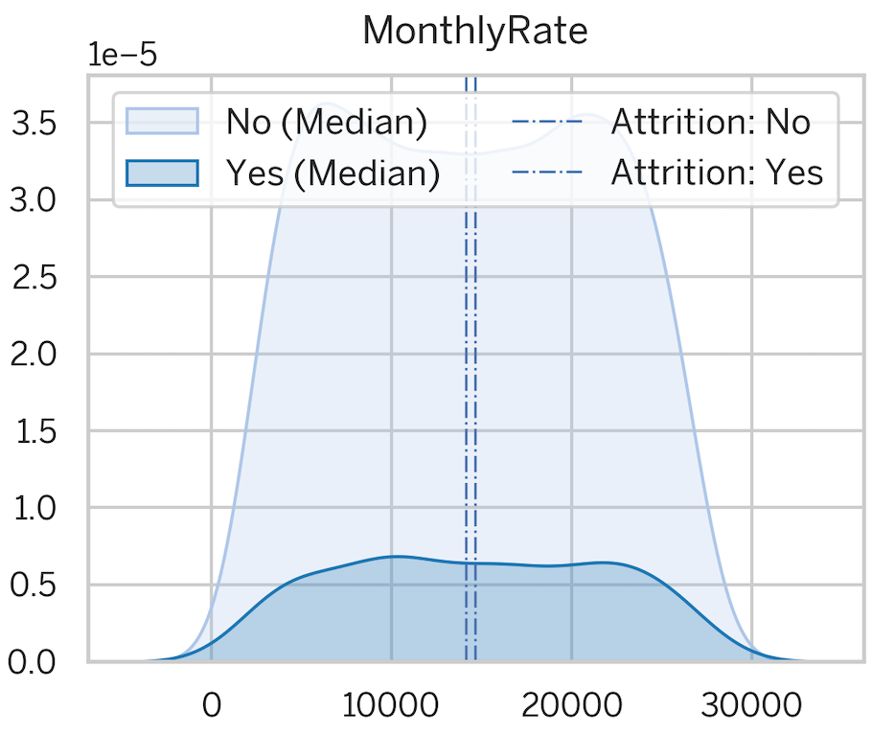
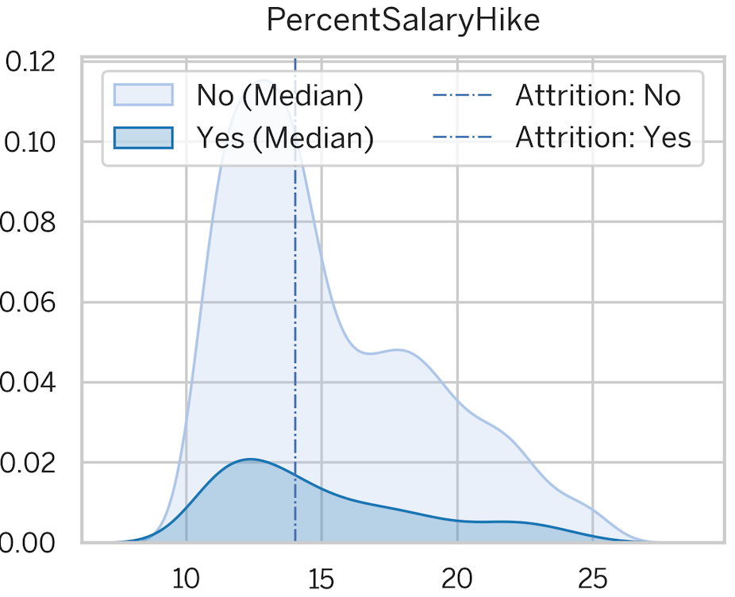
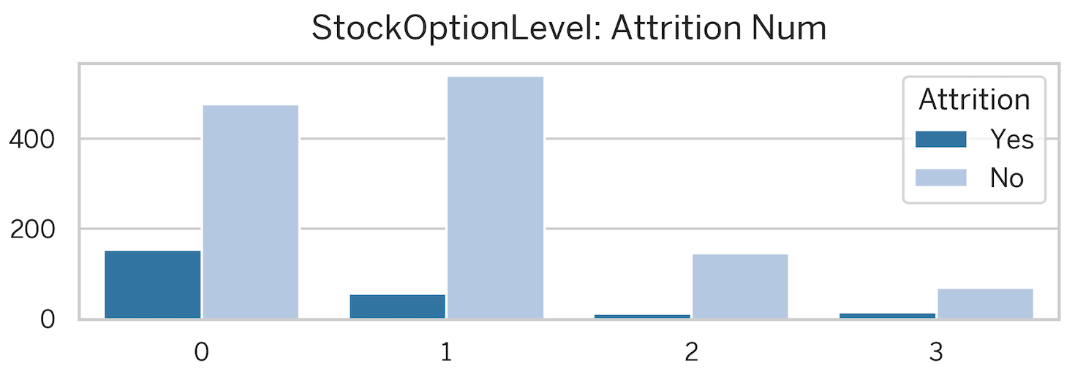
Exploring Data (Diagnostic Analytics)
How Compensation and Benefits attributes impact the attrition?
Attributes:
DailyRate, HourlyRate, MonthlyIncome, MonthlyRate, PercentSalaryHike, StockOptionLevel
Observations:
While salary may not be the primary driver of departures across the board, the data shows a higher turnover rate among employees earning lower monthly salaries (USD 0-5,000).
Further investigation into reasons for leaving specifically within this income bracket is recommended.

Slide 26
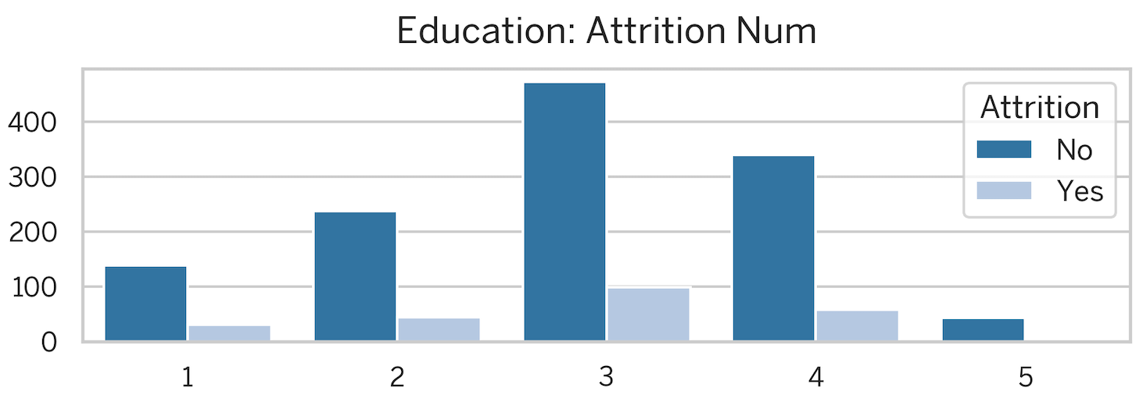
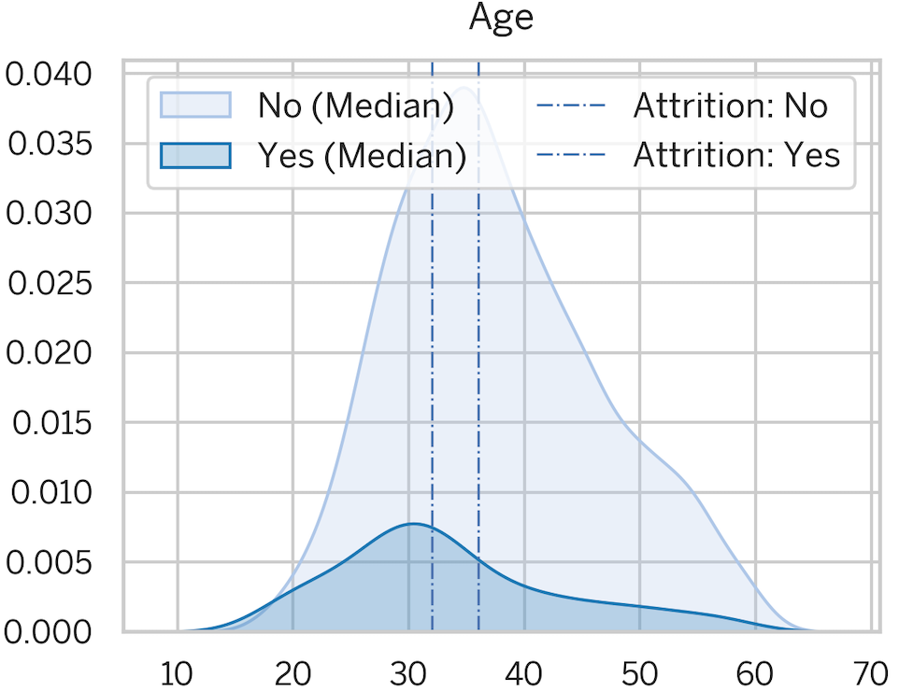
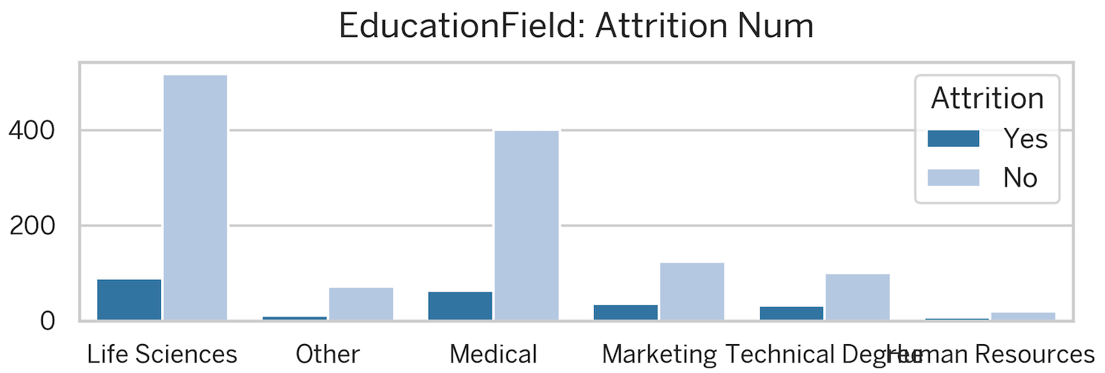
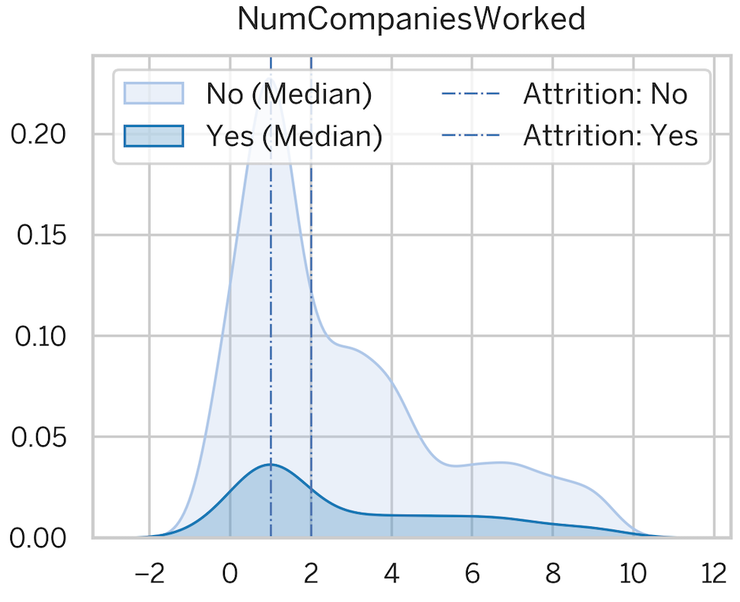
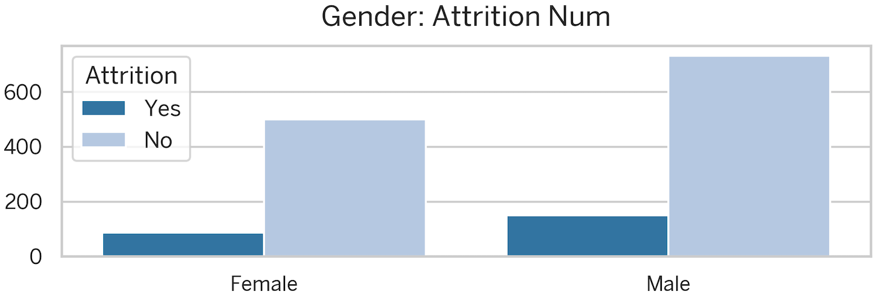
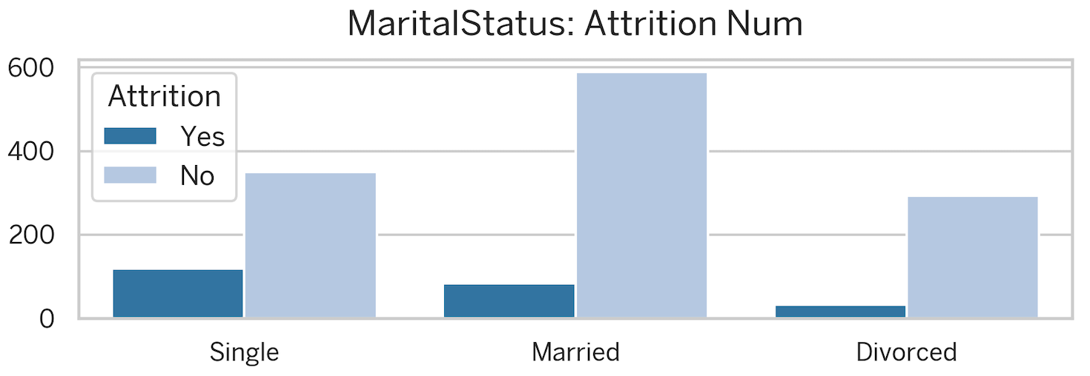
Exploring Data (Diagnostic Analytics)
How Demographic Factors attributes impact the attrition?
Attributes:
Age, Education, EducationField, Gender,
MaritalStatus, NumCompaniesWorked
Observations:
Our analysis indicates that employees who leave tend to be younger (25-35 years old) compared to those who stay.
Additionally, we see a higher turnover rate among single employees, with a greater number of men leaving the company overall (approximately 150 people).

Slide 27
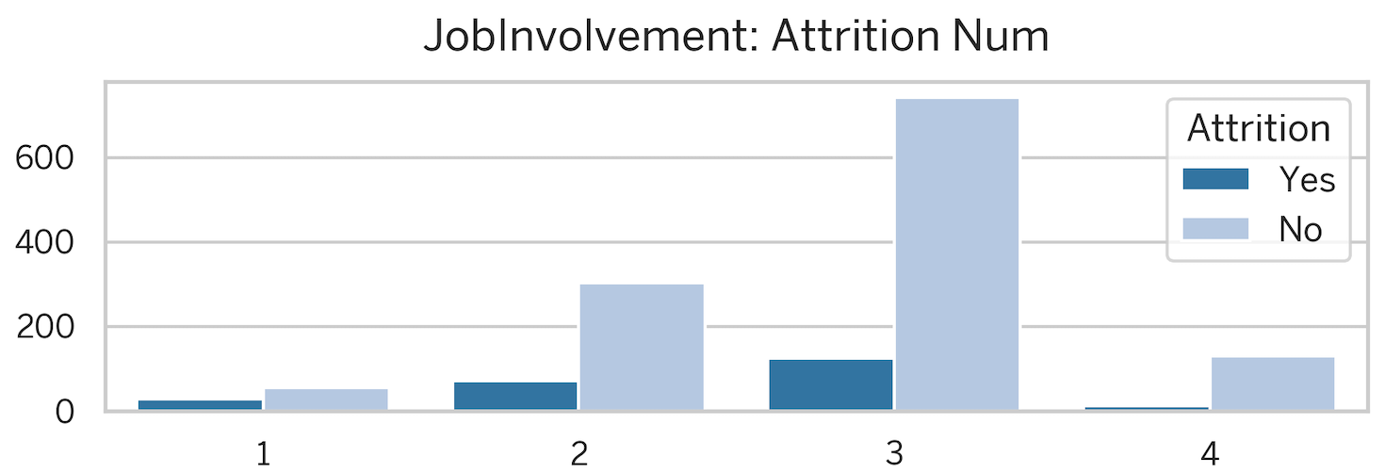
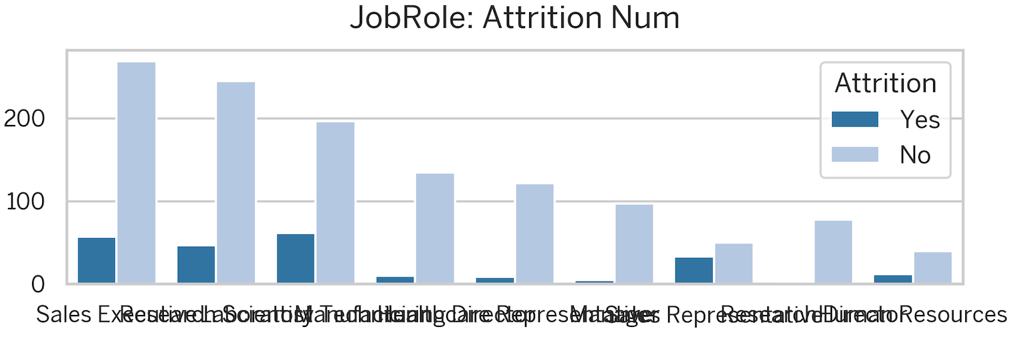
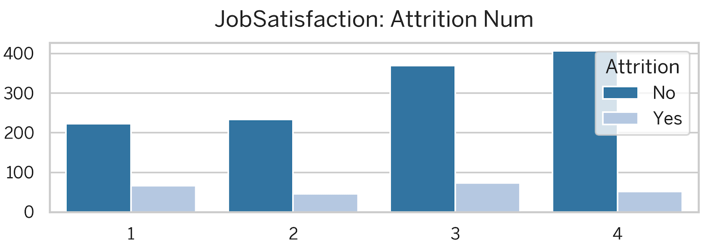
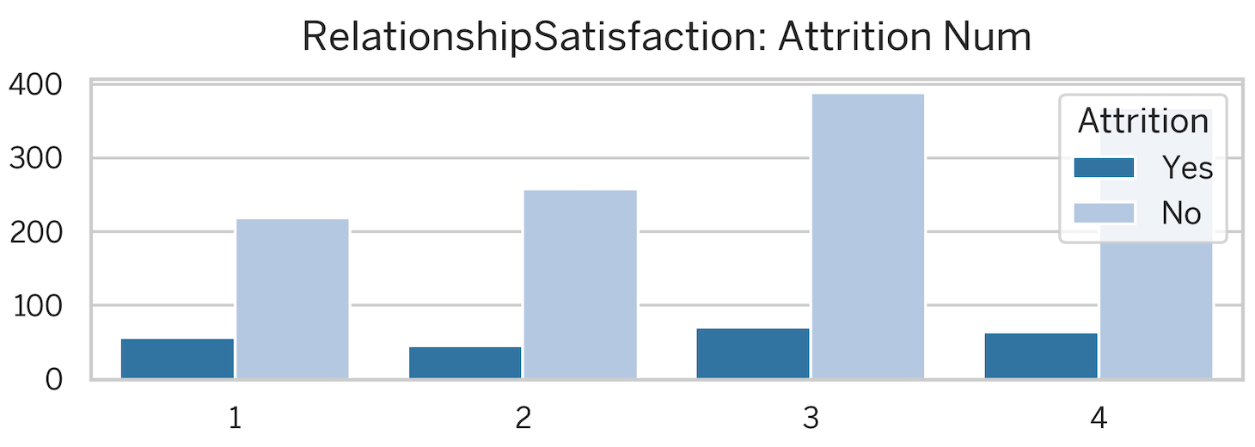
Exploring Data (Diagnostic Analytics)
How Job Satisfaction attributes impact the attrition?
Attributes:
JobInvolvement, JobRole, JobSatisfaction, RelationshipSatisfaction
Observations:
We've identified Sales Representatives, followed by Laboratory Technicians and Human Resources personnel, as having the highest turnover rates within the company.
Conversely, employees with higher job involvement tend to stay with the company longer.

Slide 28
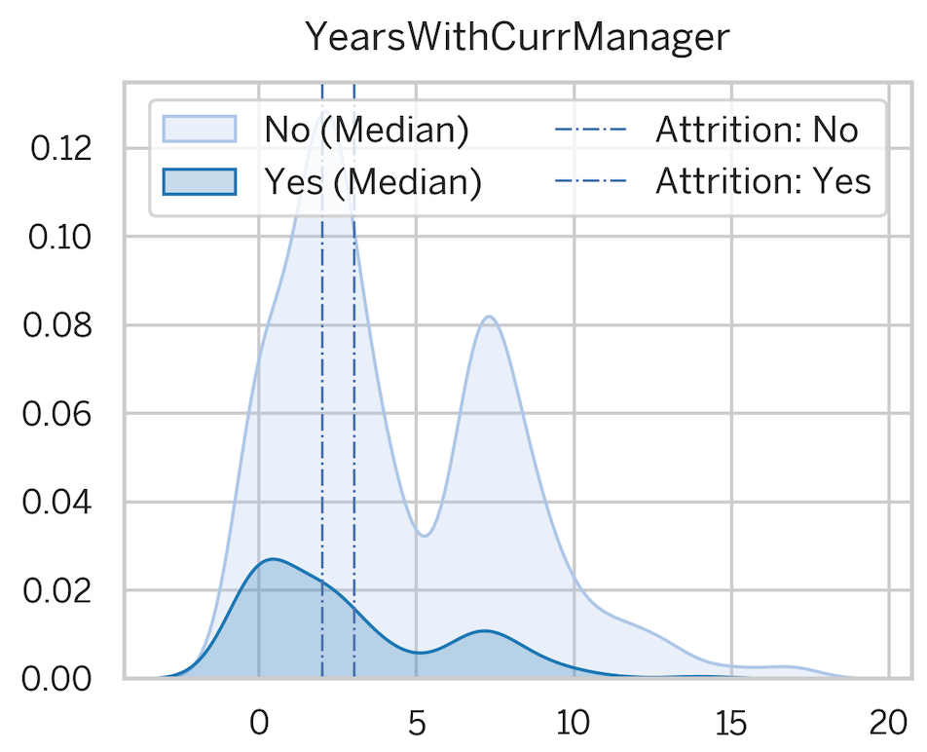
Exploring Data (Diagnostic Analytics)
How Managerial Influence attributes impact the attrition?
Attribute: YearsWithCurrManager
Observations:
We could not observe any specific pattern with respect to this attribute.

Slide 29
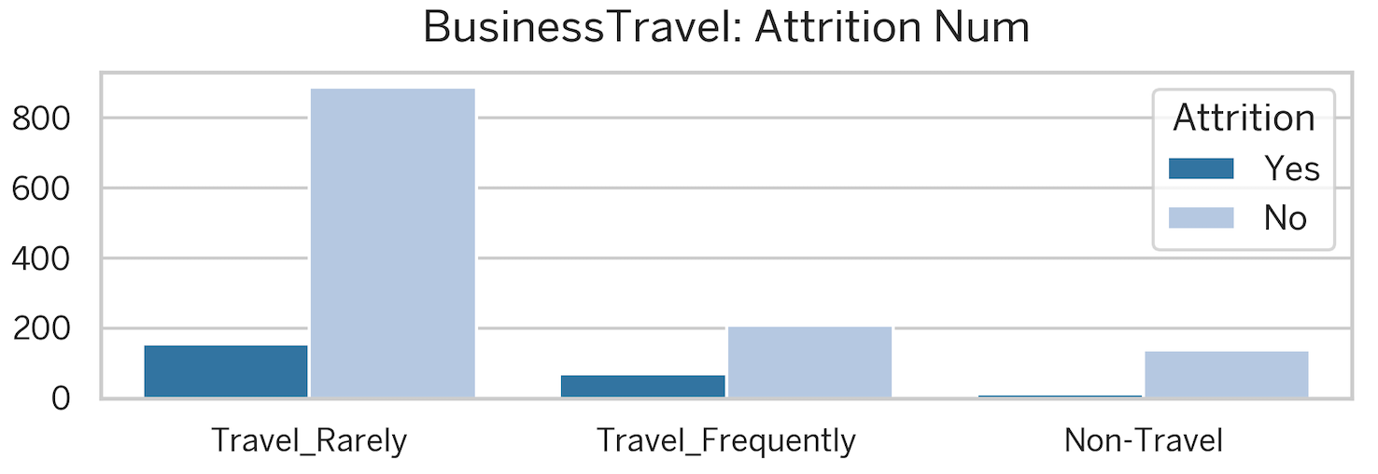
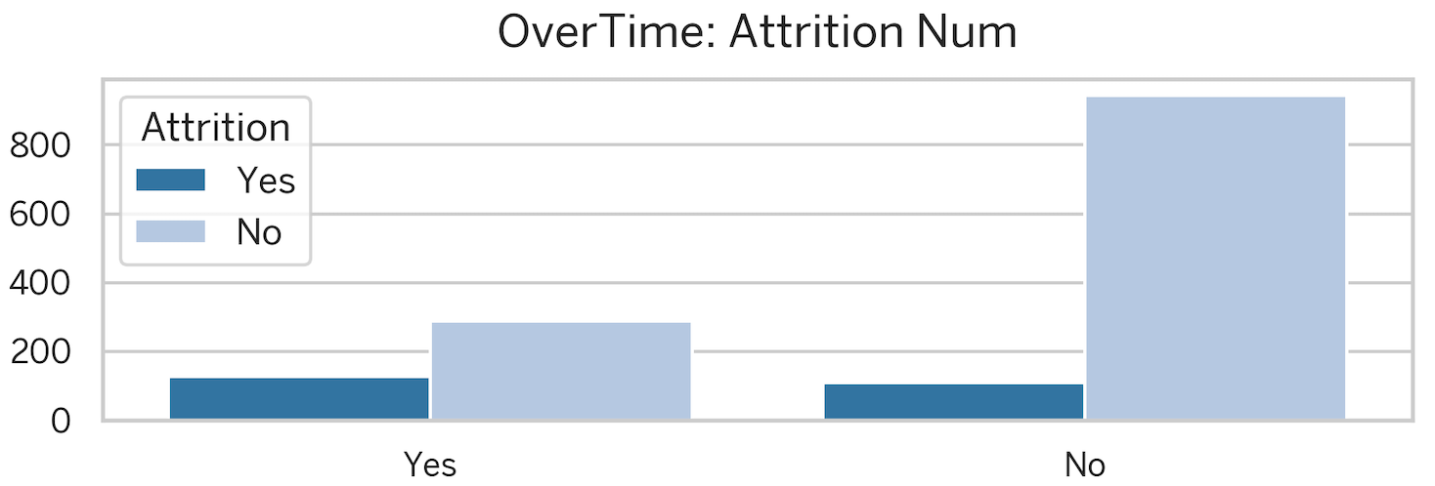
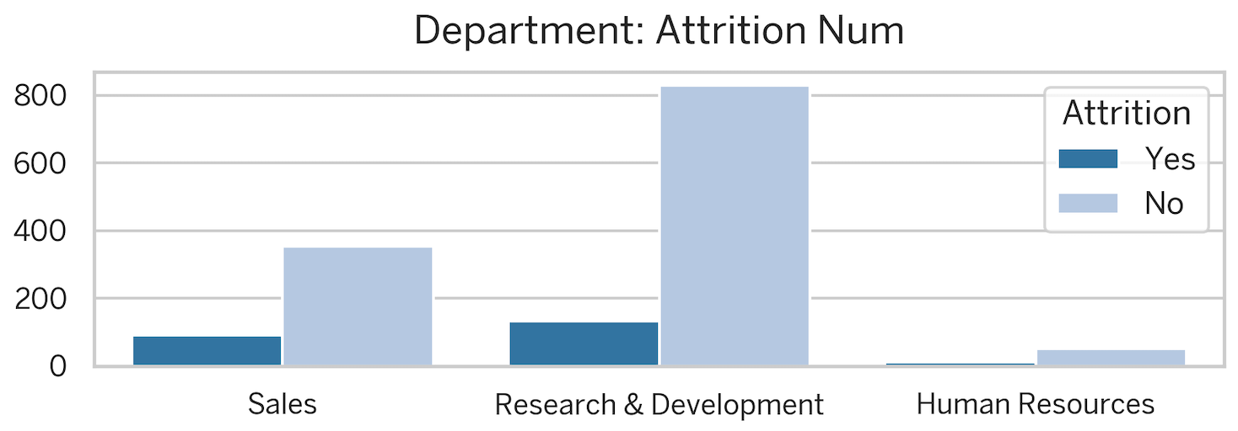
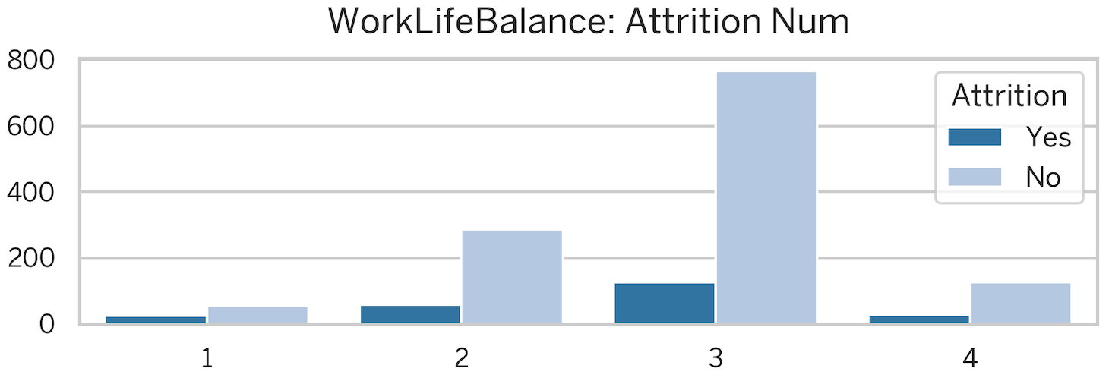
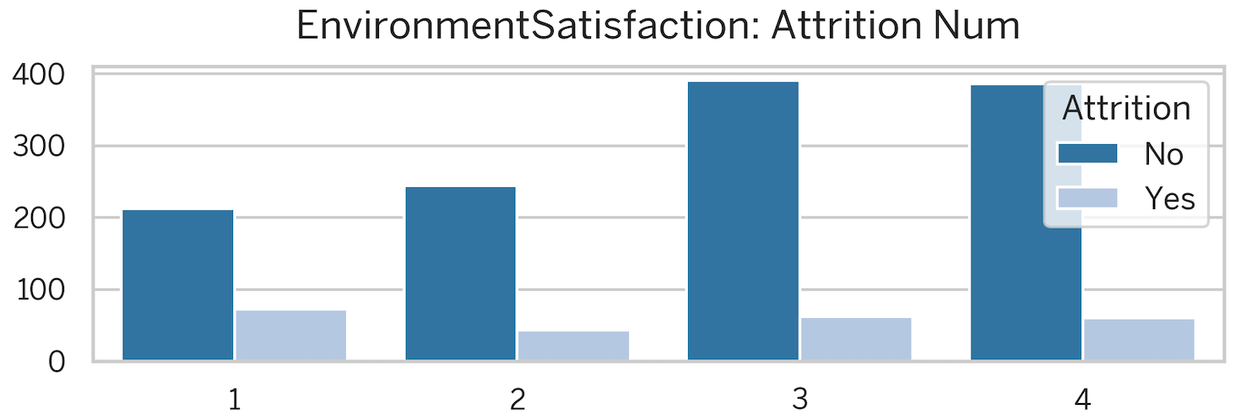
Exploring Data (Diagnostic Analytics)
How Work Environment attributes impact the attrition?
Attributes: BusinessTravel, Department, EnvironmentSatisfaction, OverTime, WorkLifeBalance
Observations:
Travel: Frequent travel correlates with higher attrition
Sales (20% attrition) has the highest rate, but R&D incurs the most cost due to size
Overtime: Employees working overtime are 3x more likely to leave (30% attrition)
Work Environment: Lower Environment Satisfaction leads to higher attrition

Slide 30




Consolidated Findings (In Simple Words)
Age: Younger employees (25-35 years old) are more likely to leave compared to those with longer tenures.
Travel: Rare Business Travel correlates with attrition. While the Sales department has the highest Attrition Rate (21%), the R&D Department incurs the most cost due to its larger size (Attrition of 128 employees).
Compensation: While salary distribution doesn't significantly differ between departing and remaining employees, lower monthly income (0 - 5,000) shows a higher turnover rate.
Overtime: Employees working overtime are three times more likely to leave (30% attrition rate).
Job Satisfaction: Lower satisfaction with the work environment (EnvironmentSatisfaction) is linked to higher turnover.
Department: Sales representatives, followed by Laboratory Technicians and HR Personnel, has the highest turnover rates. Interestingly, HR has the lowest number of employees leaving, despite a high attrition rate (25%).
Demographics: A higher number of men leave the company compared to women (approximately 150). Marital status also plays a role, with single employees showing a higher attrition rate (25%).
25-35

Slide 31




Feature Selection
 | Create new features for Machine Learning Analysis Creating Feature Groups from Age (Group Age ) Finding Median Monthly Income by Job Level (MedIncome) Creating a Feature for Below Median Income (BelowMedIncome) Creating Interaction Features (GroupAge_Overtime , JobLevel_Overtime , JobLevel_BelowMedIncome_Overtime )
 | Feature Encoding: Traditional Labelling : for columns containing binary values (e.g. Yes/No, Male/Female for Attrition, OverTime etc.) One Hot Encoding : for columns with more than two unique values(1,2,3,4,5), (e.g.: Education)
 | Feature Scaling: Standardization (StandardScaler + FitTransform) : Age Column (normal distribution) Normalization (MinMaxScalaer StandardScaler + FitTransform : Numerical Columns except Age ***sklearn.preprocessing import MinMaxScaler, StandardScaler
 | Feature Selection: Perform feature importance analysis to identify the most influential factors for employee attrition. Select a subset of features based on importance and potentially other considerations
Notes:
Traditional Labeling: Converts categorical variables with only two unique values (often "Yes" or "No") to numerical labels (typically 0 or 1). This is simple and efficient for algorithms that can handle numerical features.
One-Hot Encoding: Creates new binary columns for each unique value in a categorical variable. This increases the number of features but allows algorithms to better understand the relationships between different categories within the variable.
Standardization: Targets a standard normal distribution (mean 0, standard deviation 1) by subtracting the mean and dividing by the standard deviation. This is useful for algorithms sensitive to feature scale or assuming normality.
Normalization: Scales the data to a predefined range (often 0 to 1 or -1 to 1) based on the minimum and maximum values. This is useful for distance-based algorithms where the magnitude of the value matters.

Slide 32
Modelling Data
OSEMN
Obtaining
Data
Scrubbing
Data
Exploring
Data
Modeling
Data
iNterpreting
Data
Gather data from relevant sources
Clean data to formats that machine understands
Find patterns and trends using statistical methods
Construct models predict and forecast
Put the results into good use
Data Mining
Data
Cleansing
Descriptive
Analytics
Diagnostic
Analytics
Predictive
Analytics
Prescriptive
Analytics

Slide 33
Modelling Data (ML Model)
AS WE HAVE SEEN EARLIER…
Key Factor To Decide Between Supervised and Unsupervised Learning:
We have chosen Supervised Learning in this scenario as we have a labeled dataset and aim to make predictions.
Supervised Learning is ideal for tasks like employee churn prediction, where our goal is to classify categories or predict continuous values based on past data.
Key factor to deciding between Classification and Regression lies in target variable:
Classification: Classification model is used when target variable is discrete and falls into distinct categories. These categories can be binary (like Attrition Yes/No) or have multiple classes (e.g., classifying handwritten digits into 0-9).
Regression: Regression model is used when target variable is continuous. This means it can take on any numerical value within a range. Common examples include predicting house prices, weather forecasts (temperature), or customer lifetime value.
Supervised Learning
Unsupervised Learning
Reinforcement Learning
Classification
Regression
Clustering
Decision Making
Logistic Regression
K-Nearest Neighbor
Support Vector Machine
Decision Tree
Random Forest
XGBoost
Linear Regression
Neural Network Regression
Support Vector Regression
Decision Tree Regression
Lasso Regression
Ridge Regression
K-Means Clustering
Mean-shift Clustering
DBSCAN Clustering
Agglomerative Hierarchical Clustering
Gaussian Mixture
Q-Learning
R Learning
TD Learning

Slide 34



Data Splitting (Train + Test & Validate)
The data is prepared for training by separating features (without Attrition column) and the target variable (Attrition).
The data is split into training and testing sets using a 70:30 ratio.
The training set is used to train the machine learning model, and the testing set is used to evaluate its performance on unseen data.
It creates a validation set, which can be used for hyperparameter tuning (finding the best settings for the model).
By splitting the data into these sets, we ensured that the model is not simply memorizing the training data and can generalize well to unseen data.
Dataset 1
Dataset 2
Dataset 3
2102 rows
2102 rows
2102 rows
Train + Test
139 rows
139 rows
139 rows
Validate
The number of rows and columns of df_clean1 : (1248, 84)
The number of rows and columns of df_clean2 : (1248, 20)
The number of rows and columns of df_clean3 : (1248, 28)
The number of rows and columns of df_valid1 : (139, 84)
The number of rows and columns of df_valid2 : (139, 20)
The number of rows and columns of df_valid3 : (139, 28)

Slide 35

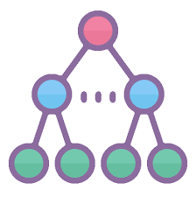

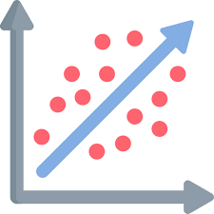

Classification Models Used
K-Nearest Neighbor
Support Vector Machine
Decision Tree
Random Forest
Logistic Regression
XGBoost

Slide 36
Classification Report Metrics Used
Accuracy — This metric measures the proportion of correct predictions made by the model across the entire dataset. It is calculated as the ratio of true positives (TP) and true negatives (TN) to the total number of samples.
Precision — Precision measures the proportion of true positive predictions among all positive predictions made by the model. It is calculated as the ratio of TP to the sum of TP and false positives (FP).
Recall — Recall, also known as sensitivity or true positive rate, measures the proportion of true positive predictions among all actual positive instances. It is calculated as the ratio of TP to the sum of TP and false negatives (FN).
F1 Score — F1 Score is a metric that balances precision and recall. It is calculated as the harmonic mean of precision and recall. F1 Score is useful when seeking a balance between high precision and high recall, as it penalizes extreme negative values of either component.
ROC AUC (Receiver Operating Characteristic - Area Under Curve) — This metric is used to measure the performance of a classification model at various threshold settings. The ROC is a probability curve and AUC represents the degree or measure of separability. It tells how much the model is capable of distinguishing between classes.

Slide 37
Classification Report
 | Model | Accuracy | Precision | Recall | F1 | AUC
Dataset 1 | Logistic Regression (1) | 0.848921 | 0.761905 | 0.5 | 0.603774 | 0.726636
 | Support Vector Machine (1) | 0.791367 | 0.548387 | 0.53125 | 0.539683 | 0.700204
 | Random Forest (1) | 0.769784 | 0.5 | 0.46875 | 0.483871 | 0.664282
 | K-Nearest Neighbor (1) | 0.676259 | 0.341463 | 0.4375 | 0.383562 | 0.592582
 | Decision Tree (1) | 0.705036 | 0.354839 | 0.34375 | 0.349206 | 0.578417
 | XGBoost (1) | 0.805755 | 0.619048 | 0.40625 | 0.490566 | 0.665742
Dataset 2 | Logistic Regression (2) | 0.676259 | 0.385965 | 0.6875 | 0.494382 | 0.680199
 | Support Vector Machine (2) | 0.654676 | 0.362069 | 0.65625 | 0.466667 | 0.655228
 | Random Forest (2) | 0.741007 | 0.428571 | 0.375 | 0.4 | 0.612734
 | K-Nearest Neighbor (2) | 0.633094 | 0.306122 | 0.46875 | 0.37037 | 0.575496
 | Decision Tree (2) | 0.719424 | 0.36 | 0.28125 | 0.315789 | 0.565859
 | XGBoost (2) | 0.748201 | 0.4 | 0.1875 | 0.255319 | 0.551694
Dataset 3 | Logistic Regression (3) | 0.726619 | 0.434783 | 0.625 | 0.512821 | 0.691005
 | Support Vector Machine (3) | 0.683453 | 0.384615 | 0.625 | 0.47619 | 0.662967
 | Random Forest (3) | 0.769784 | 0.5 | 0.40625 | 0.448276 | 0.642377
 | K-Nearest Neighbor (3) | 0.654676 | 0.34 | 0.53125 | 0.414634 | 0.611419
 | Decision Tree (3) | 0.697842 | 0.272727 | 0.1875 | 0.222222 | 0.518984
 | XGBoost (3) | 0.76259 | 0.454545 | 0.15625 | 0.232558 | 0.550088
From the comparison table above, it is found that;
Logistic Regression (1) is the best algorithm with the highest
Accuracy and
F1 score

Slide 38
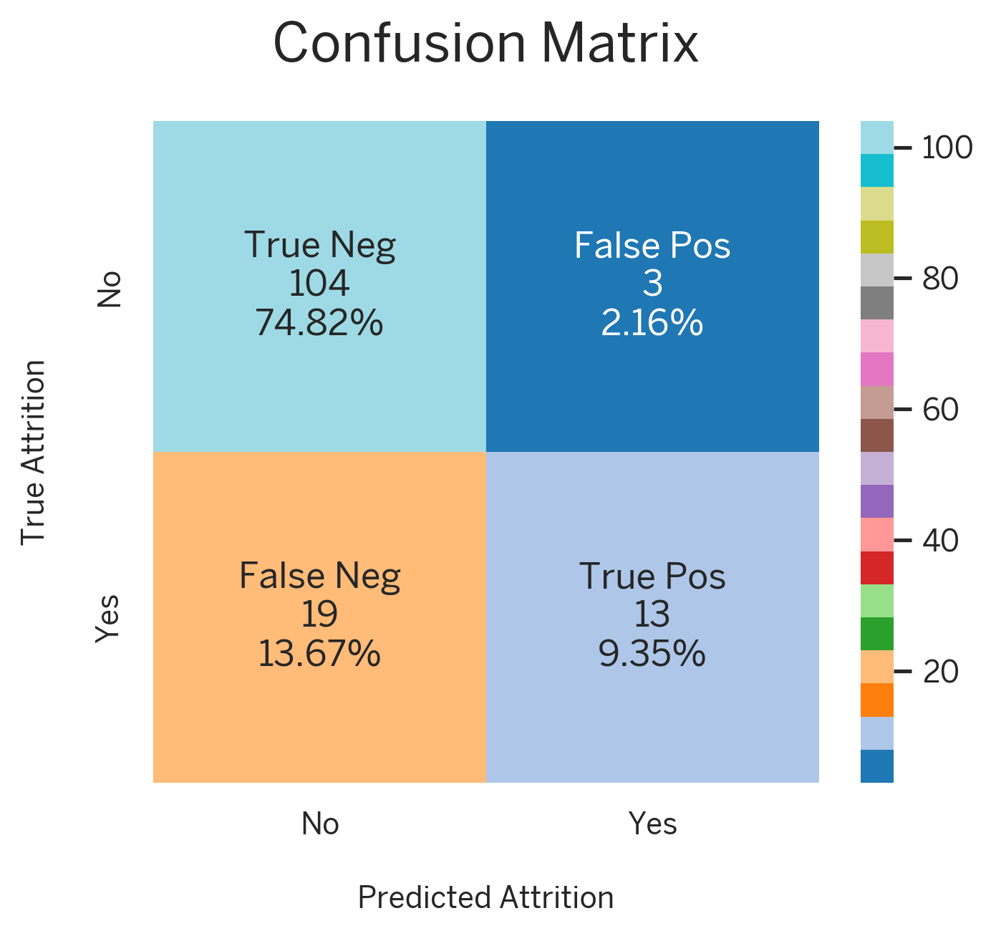
Final Training Model
The confusion matrix summarizes how many data points were correctly or incorrectly classified into different categories.
Carrying out model training using the Logistic Regression algorithm with all features scenario.

Slide 39
iNterpreting Data
OSEMN
Obtaining
Data
Scrubbing
Data
Exploring
Data
Modeling
Data
iNterpreting
Data
Gather data from relevant sources
Clean data to formats that machine understands
Find patterns and trends using statistical methods
Construct models predict and forecast
Put the results into good use
Data Mining
Data
Cleansing
Descriptive
Analytics
Diagnostic
Analytics
Predictive
Analytics
Prescriptive
Analytics

Slide 40
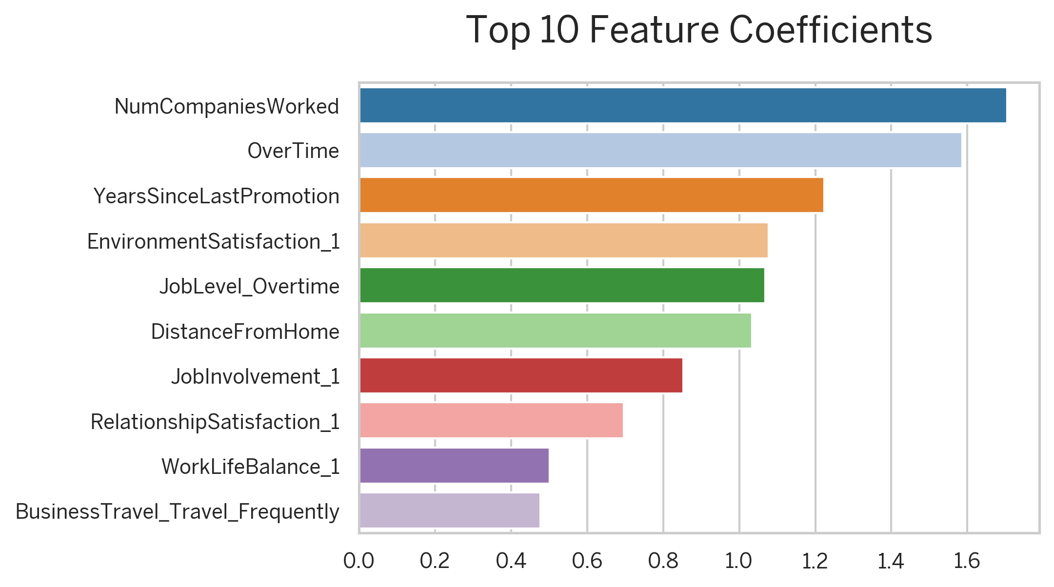
Coefficients Feature
Analyze the coefficients of a trained Logistic Regression model to understand the relative importance of features in predicting the target variable.
Based on the top list of Coefficient Feature, we can predict that
'OverTime' and
'YearsSinceLastPromotion’
are the key factors affecting attrition.
‘NumCompaniesWorked’ feature cannot be controlled by ABC Technologies’ HR Department to reduce the Attrition, hence not used.

Slide 41
Data Interpretation & Recommendations
With the help of ML models, the probability of potential employees leaving the company (before the treatment) was 142 out of 1470 people (i.e. 9.66%).
Following up on the prediction results, the HR department recommend ABC Technologies leadership to treat employees based on features with high coefficient values i.e. Overtime and Years Since Last Promotion.
What To Look For?
Are there employees with a performance rating above average (excellent and outstanding) which means they deserve to be promoted, but have not received a promotion for years?
Are there employees who work overtime, despite they have low job involvement?

Slide 42
Recommendation Flow for Simulation
Predicted Attrition
Work Overtime?
Years Since Last Promotion?
Yes
No
<2 Years
>2 Years
Job Involvement?
N/A
N/A
Performance Rating?
Low
High
Excellent or Outstanding?
Low or Good?
INVOLVE
N/A
PROMOTE
N/A
In this case we try to increase 1 Job Involvement level by filtering as follows:
Predicted attrition = Yes
Job involvement <= 3
Overtime = Yes
Data changes made:
Increase a level of Job Involvement, for example: from 1 to 2, 2 to 3, etc.
In this case, we try to give promotions to several employees who are worthy of promotion by filtering as follows:
Predicted attrition = Yes
Performance rating >= 3 (excellent and outstanding)
Years since last promotion >= 2 (last promoted above equals 2 years)
Data changes made:
Increase Job Level by 1, for example: from 1 to 2, 2 to 3, etc.
Changed the Years Since Last Promotion value to 0

Slide 43
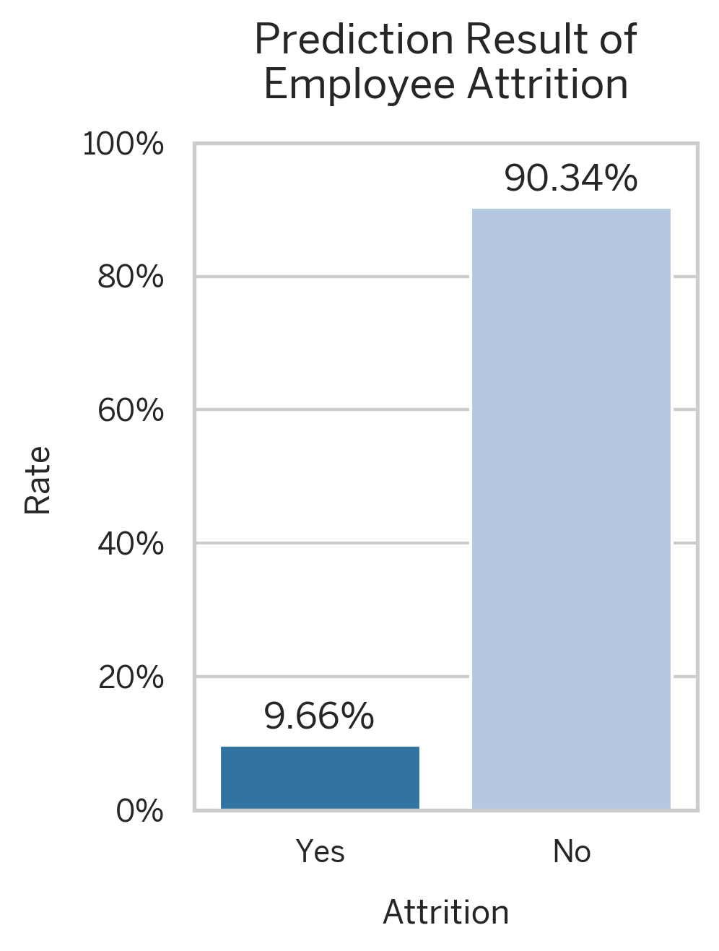

Results Pre & Post Simulation
INVOLVE
PROMOTE
The attrition rate reduced from 9.66% to 6.67% (reduced 2.99%), leaving only 98 employees with the potential to leave the company.

Slide 44

Recommendation To Leadership
The HR Analytics Department, would recommend the leadership team to;
PROMOTE!
Pay attention to the performance of your employees who are entitled to a promotion
INVOLVE!
Improve The Job Involvement of Employees:
Coaching or mentoring, and give positive feedback
Employee involvement programs
Open-communication and suggestion boxes
Reduce Employee’s Overtime:
Cross-train your employees
Try flexible work schedules

Slide 45




Bibliography
Link to the Google Colab notebook:
https://go.vivekkulthe.com/iimk-dsai
This presentation has been designed using images from
https://www.flaticon.com
https://www.dreamstime.com
Dataset used for this project is taken from
https://www.kaggle.com

